Slide 1
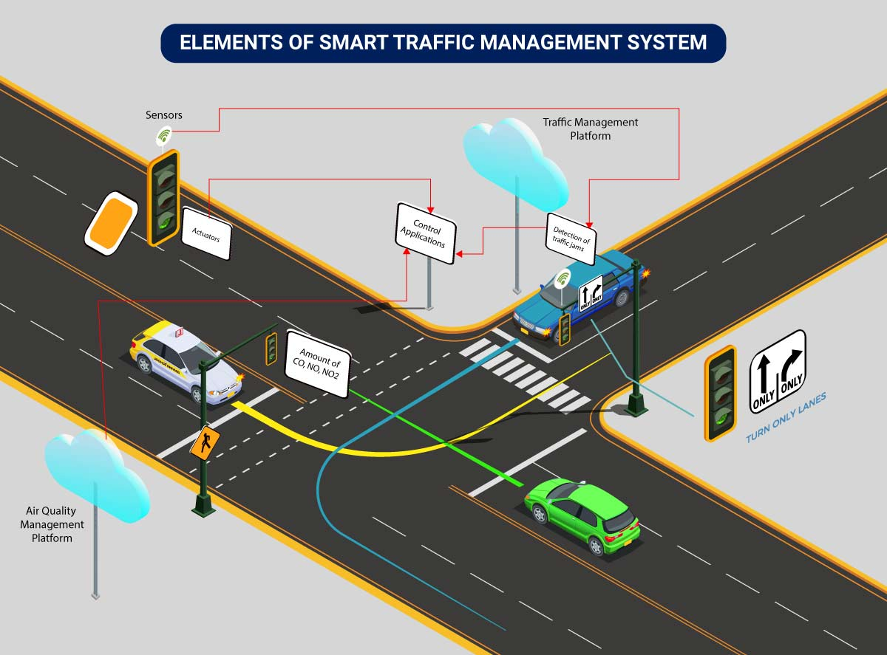


Neuro Fleet X –AI Powered Fleet Management System
GANESH S
-TEAM B

Slide 2

Neuro Fleet X –AI Powered Fleet Management System
PROBLEM STATEMENT
Traffic is becoming hard to control. We need an AI system that shows live traffic, predicts congestion, detects risk zones, and gives the best route for vehicles.
Analyze traffic conditions continuously
Detect congestion before it becomes severe
Identify and highlight dangerous or high-density zones
Optimize travel routes for vehicles (human + autonomous)
Help traffic authorities (managers) monitor and update traffic data
Allow admins to manage system operations effortlessly

Slide 3
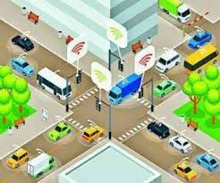
Neuro Fleet X –AI Powered Fleet Management System
Our system brings all features into one platform with three main users:
Admin – Controls the entire system
Manager – Monitors and manages traffic
Driver – Uses the route and traffic services

Slide 4
Neuro Fleet X –AI Powered Fleet Management System
ADMIN
MANAGER
DRIVER
Controls the entire platform
Adds managers and vehicles (human or autonomous)
Views all city vehicle movement (live map)
Monitors congestion, risk zones, and alerts
Uses AI reports to make decisions
Monitors traffic flow in different areas
Updates traffic density (for humans driving in crowded areas)
Verifies AI predictions
Checks vehicle statuses (both human + autonomous)
Manages risk zones and congestion alerts
Enters Source → Destination
Receives optimized AI route
Views traffic alerts and risk zone warnings
Updates GPS location
Checks vehicle health and performance

Slide 5
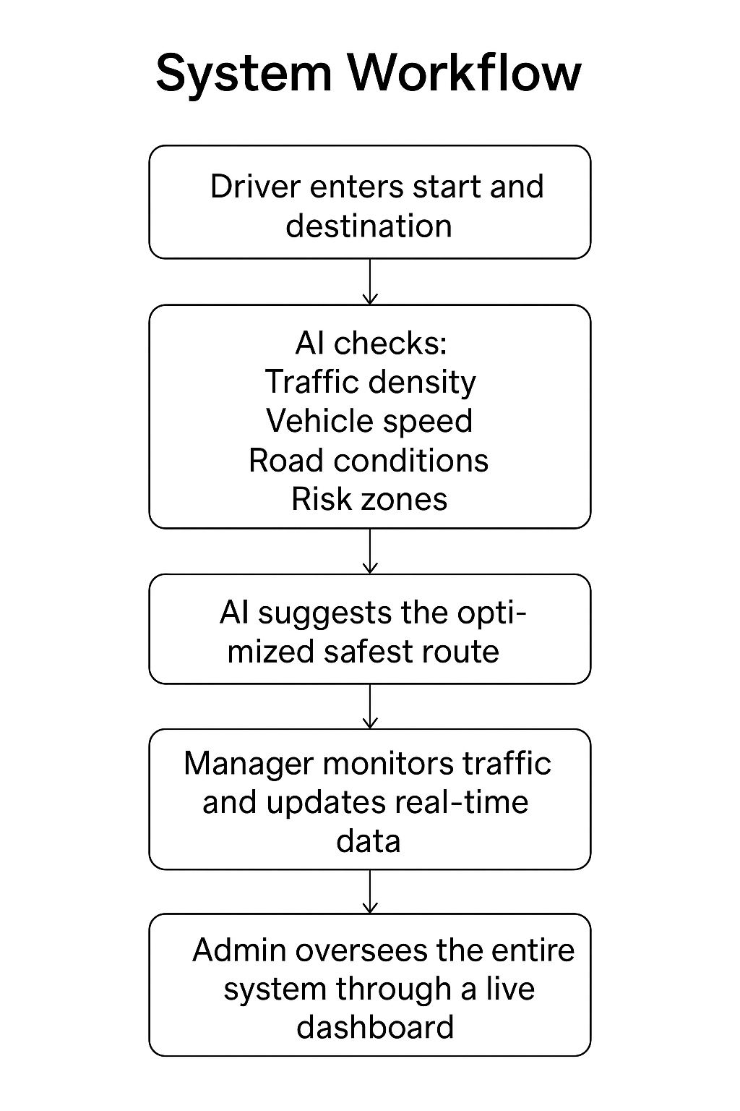
Neuro Fleet X –AI Powered Fleet Management System
System Workflow :
Driver (human or autonomous) enters Start and Destination.
AI checks:
Traffic density
Vehicle speed
Road conditions
Risk zones
AI suggests the optimized safest route.
Manager monitors traffic and updates real-time data.
Admin oversees the entire system through a live dashboard.
System continually updates predictions to keep routes safe and efficient.

Slide 6

Neuro Fleet X –AI Powered Fleet Management System
ADMIN ROLE (system owner)
1. Secure login
Admin logs in using authentication.
2. Dashboard overview
View total vehicles (human + autonomous)
Monitor traffic status
Identify live risk zones and congestion heatmaps
3. Vehicle management
Add, edit, or delete vehicle records
Track fuel level, status, and assignment
4. User management
Create and manage manager and driver accounts
5. AI monitoring tools
Congestion prediction
Risk zone detection
Intelligent route insights and analytics

Slide 7
Neuro Fleet X –AI Powered Fleet Management System
My responsibilities in the admin module include:
Login functionality: secure admin login using JWT
Managing users: adding and updating managers and drivers
AI insights: displaying congestion levels, identifying risk zones, and showing ai-recommended routes

Slide 8
THANK YOU

